Slide 1

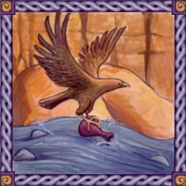


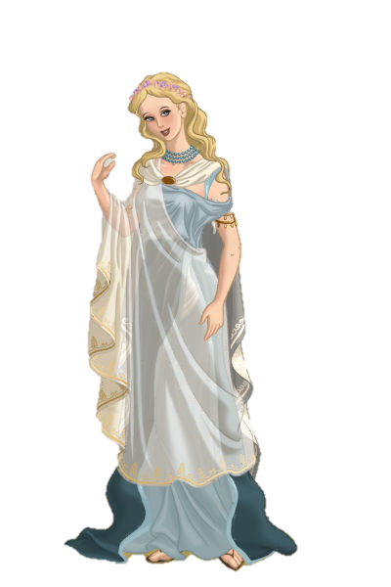
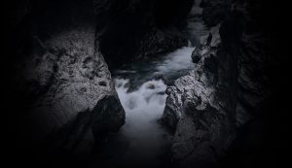
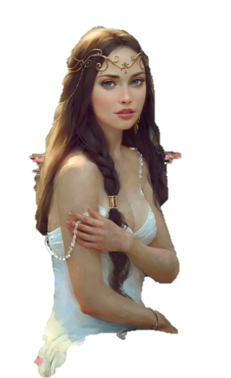
TASK 3
Fill a crystal flask with the black water from the Rivers Styx .
Next

Slide 2

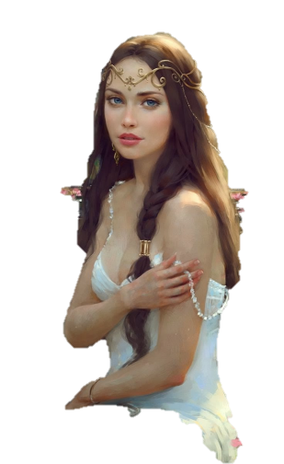
This is the worst task yet. Only a winged creature could reach it.
Next

Slide 3


You can help Psyche by answering the following questions. If you were able to answer them all correctly, I’ll do the task for her.
Next

Slide 4
Are you Ready?
3
2
1
GO

Slide 5






Next

Slide 6
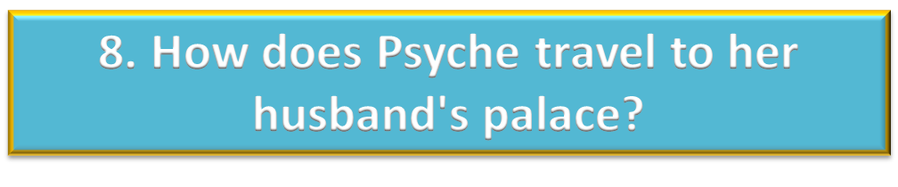




Next

Slide 7






